Slide 1

Computer Programming for Engineers
Week 8 Lecture 2
Oct. 20, 2022
Lecturer: Mohammad Mahdi Javidan
College of Engineering, Sungkyunkwan University
Fall Semester 2022

Slide 2

Monte Carlo Methods
What is the probability that the two numbers are different when rolling two dice?
Sample space
 | 1 | 2 | 3 | 4 | 5 | 6
1 | (1,1) | (1,2) | (1,3) | (1,4) | (1,5) | (1,6)
2 | (2,1) | (2,2) | (2,3) | (2,4) | (2,5) | (2,6)
3 | (3,1) | (3,2) | (3,3) | (3,4) | (3,5) | (3,6)
4 | (4,1) | (4,2) | (4,3) | (4,4) | (4,5) | (4,6)
5 | (5,1) | (5,2) | (5,3) | (5,4) | (5,5) | (5,6)
6 | (6,1) | (6,2) | (6,3) | (6,4) | (6,5) | (6,6)
$$p=\frac{6×5}{6×6}=0.83\overline{3}$$
College of Engineering, Sungkyunkwan University

Slide 3
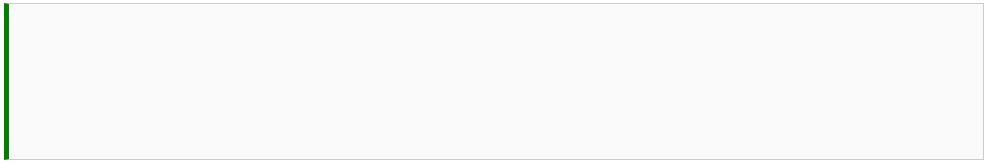
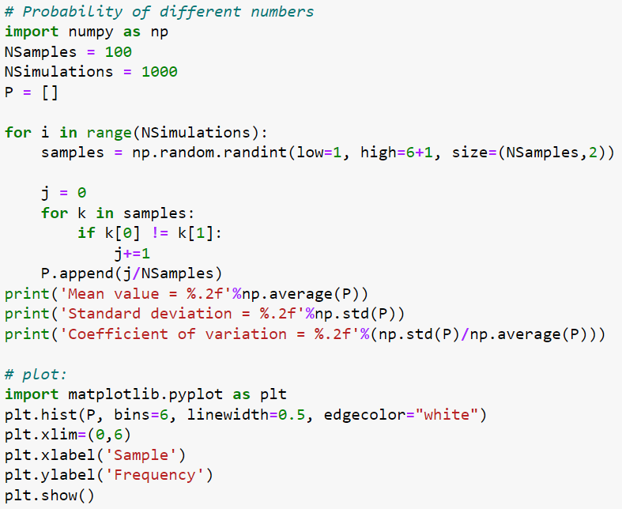
Monte Carlo Methods
Mean and standard deviation
College of Engineering, Sungkyunkwan University

Slide 4
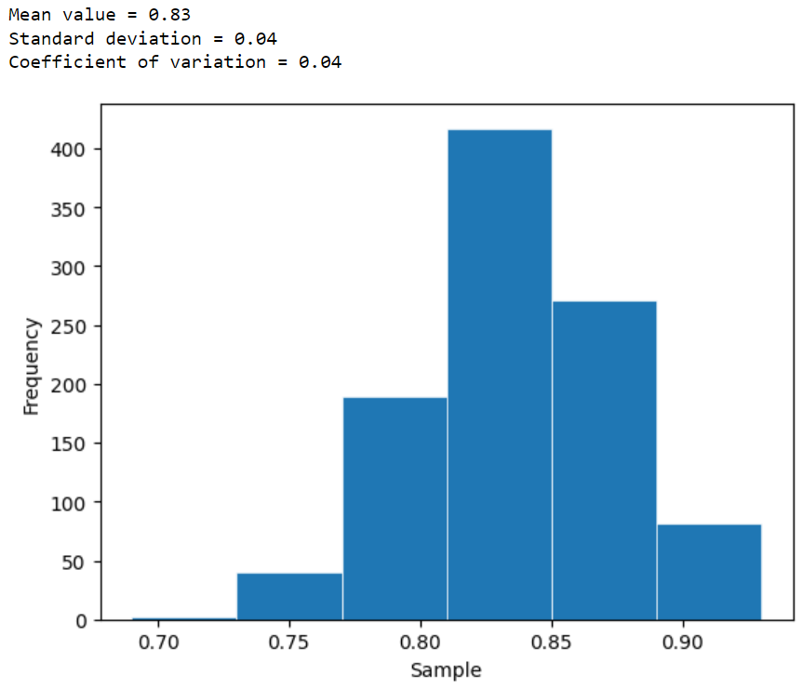
Monte Carlo Methods
College of Engineering, Sungkyunkwan University

Slide 5
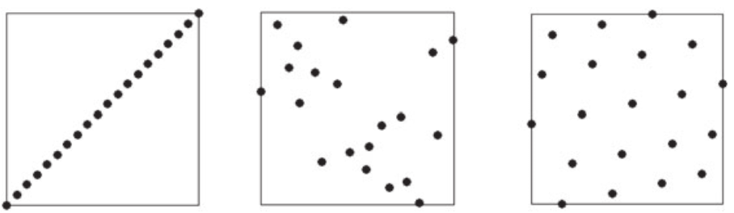
Monte Carlo Methods
Design with very poor space filling properties
Random design
Design with good space filling properties
Source: Felip .A.C.Viana, “A Tutorial on Latin Hypercube Design of Experiments.” Quality and Reliability Engineering International, 2015.
College of Engineering, Sungkyunkwan University

Slide 6

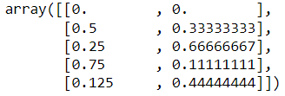
Monte Carlo Methods
Quasi Monte Carlo simulation
Halton sequence for sampling
College of Engineering, Sungkyunkwan University

Slide 7
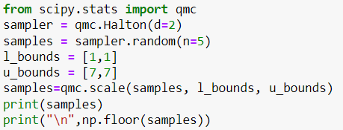
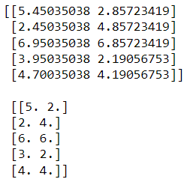
Monte Carlo Methods
Skipping
Leaping
Scrambling
College of Engineering, Sungkyunkwan University

Slide 8
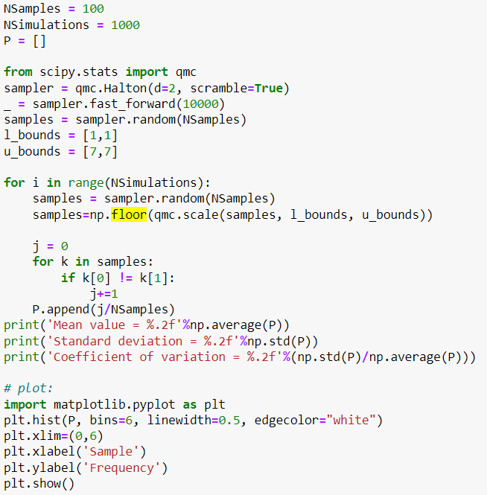
Monte Carlo Methods
The dice problem!
What is the probability that the two numbers are different when rolling two dice?
College of Engineering, Sungkyunkwan University

Slide 9

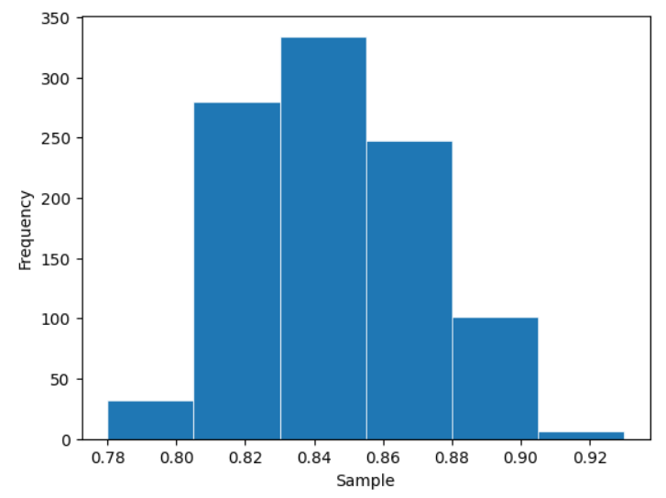
Monte Carlo Methods
College of Engineering, Sungkyunkwan University

Slide 10
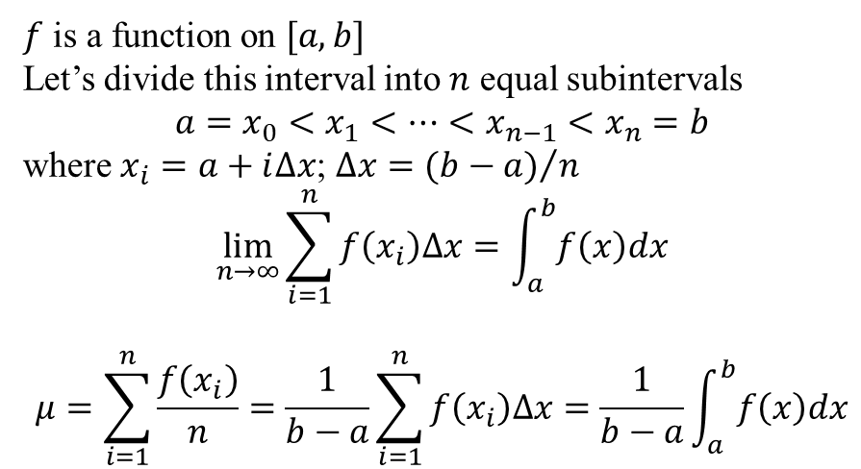
Monte Carlo Methods
$f$ is a function on $[a,b]$
Let’s divide this interval into $n$ equal subintervals
$$a=x_{0}<x_{1}<…<x_{n−1}<x_{n}=b$$
where $x_{i}=a+i∆x$; $∆x={(b−a)}/n$
$$\lim_{n→∞}{\sum_{i=1}^{n}{f\left(x_{i}\right)∆x}}=\int_{a}^{b}{f\left(x\right)dx}$$
$$μ=\sum_{i=1}^{n}{\frac{f\left(x_{i}\right)}{n}}=\frac{1}{b−a}\sum_{i=1}^{n}{f\left(x_{i}\right)∆x}=\frac{1}{b−a}\int_{a}^{b}{f\left(x\right)dx}$$
College of Engineering, Sungkyunkwan University

Slide 11
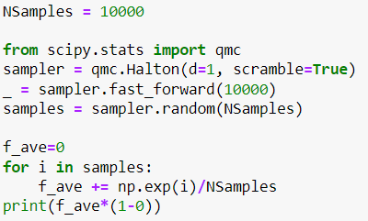
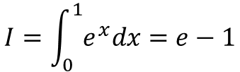
Monte Carlo Methods
$$I=\int_{0}^{1}{e^{x}dx}=e−1$$
College of Engineering, Sungkyunkwan University

Slide 12
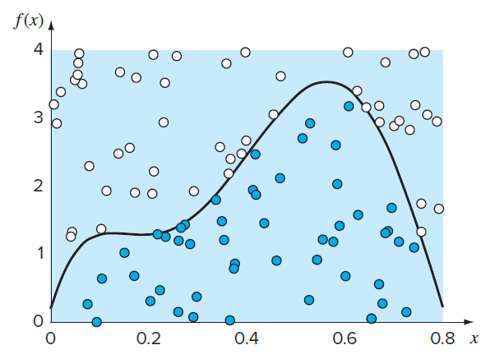

Monte Carlo Methods
Dartboard Monte Carlo integration
College of Engineering, Sungkyunkwan University

Slide 13
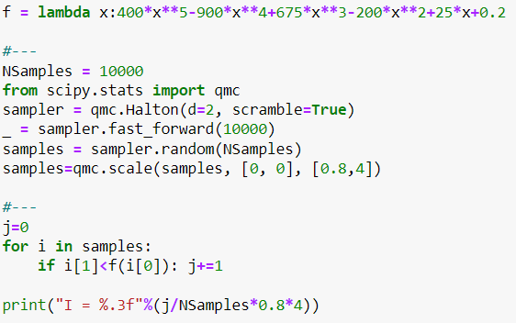
Monte Carlo Methods
College of Engineering, Sungkyunkwan University

Slide 14
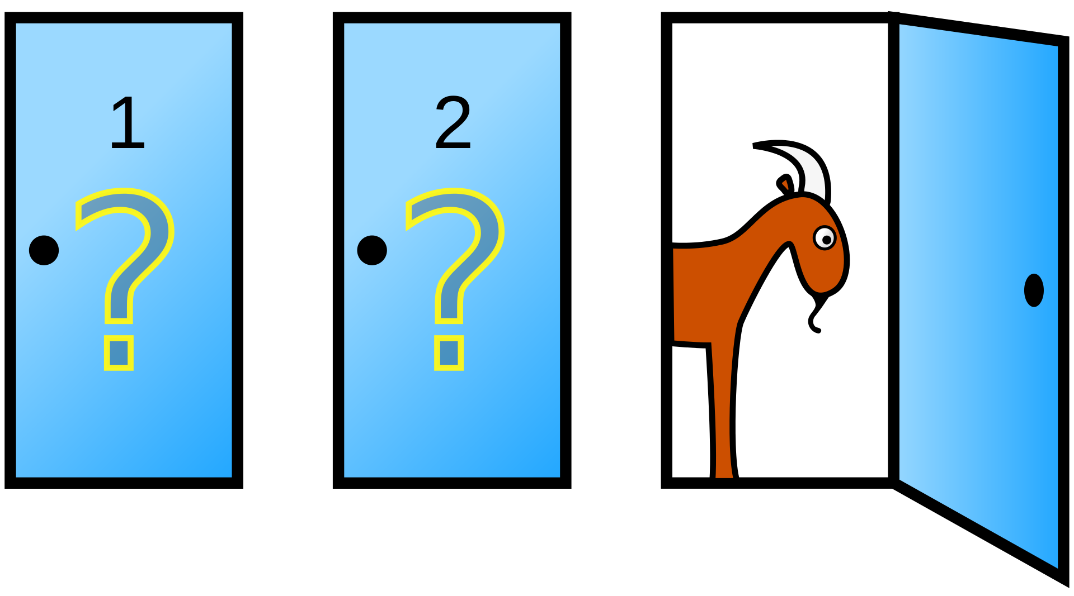
Monty Hall Problem
Suppose you're on a game show, and you're given the choice of three doors:
Behind one door is a car; behind the others, goats.
The host knows what's behind the doors
You pick a door
The host opens another door which has a goat. He then says to you, "Do you want to pick door No. 2?“
Is it to your advantage to switch your choice?
Source: https://en.wikipedia.org/wiki/Monty_Hall_problem
College of Engineering, Sungkyunkwan University

Slide 15
Team Project
Write a code for finding the inverse of a matrix using the Gauss-Jordan method.
Simulate the Monty Hall problem and find the probability of winning when changing the door and compare it with the strategy remaining with the initial choice.
Take these things into consideration:
The code should be user-friendly.
The code needs to be well-documented with comments so that anyone can understand it.
You need to prepare the presentation properly and timing is important.
Presenting is very important, decide how you are going to show your work.
You have to be able to answer questions from other students.
Etc.
College of Engineering, Sungkyunkwan University

